Slide 1

SALARY PREDICTION
of Data professions

Slide 2

LET'S GO!
First we have to do the data preprocessing which includes the removal of outliers, filling or removal of missing values in the given data and get dummies for string values.
And then we have to train different models on the data.
and then compare the metrics to know the better model.

Slide 3
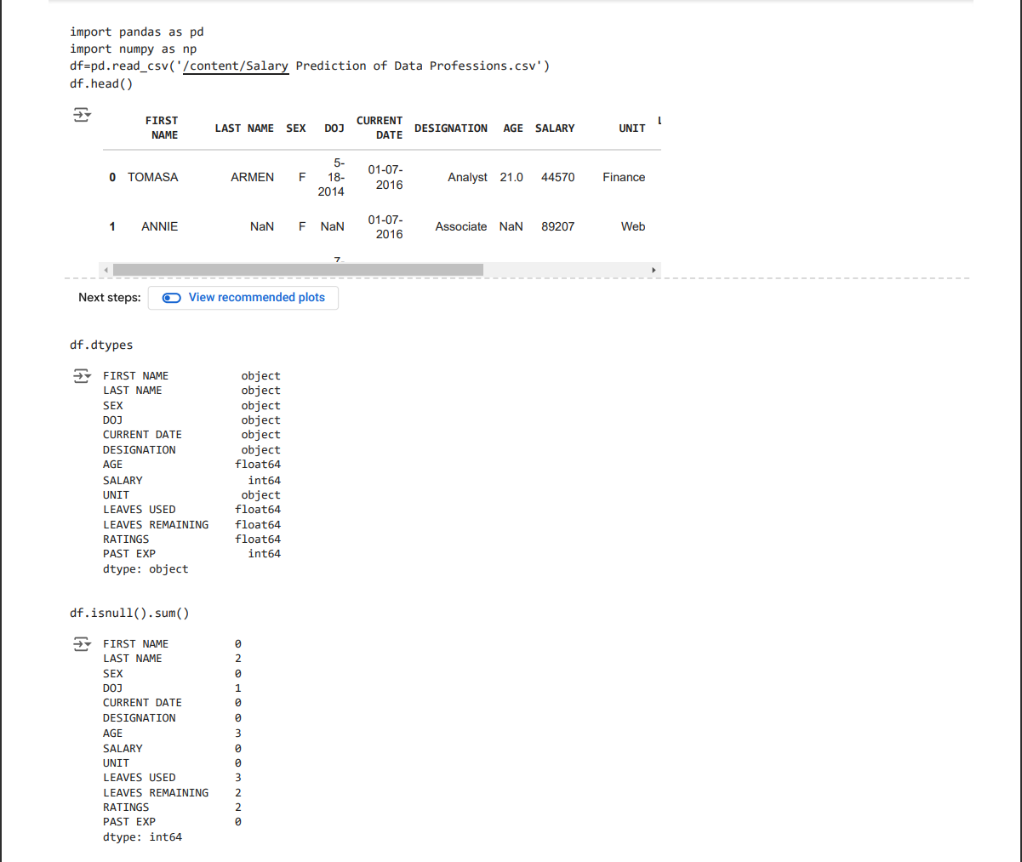

DATA PREPROCESSING
At first go through the data and observe the data types and number of missing value in each columns.

Slide 4

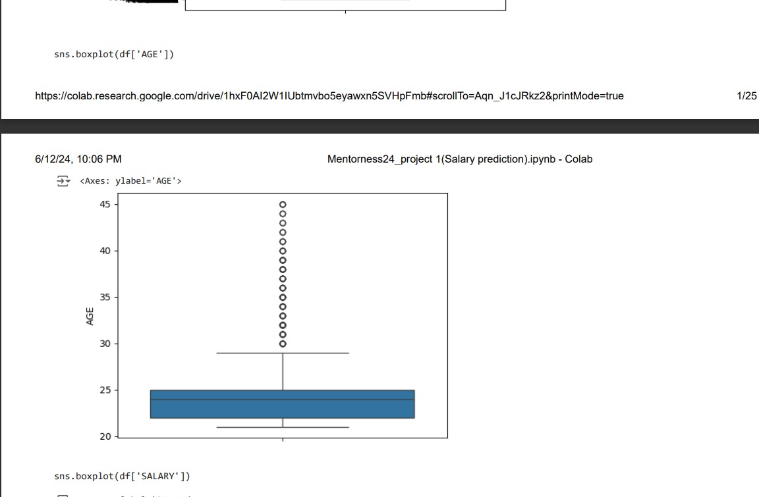
Now we have to remove the outliers by checking every column of given
data. The outliers are present in AGE,SALARY,PAST EXP columns

Slide 5

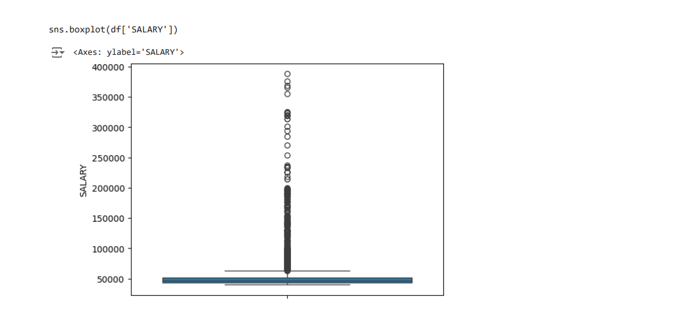

Slide 6
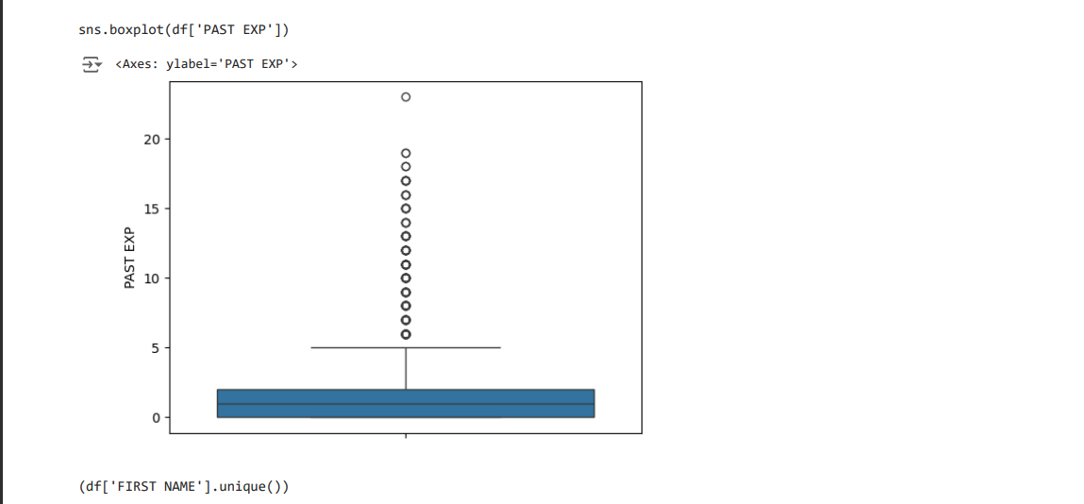

Slide 7
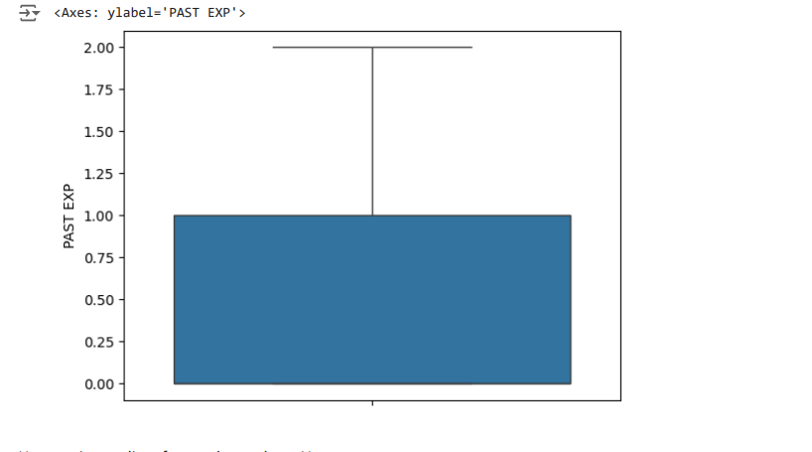

After removing outliers

Slide 8
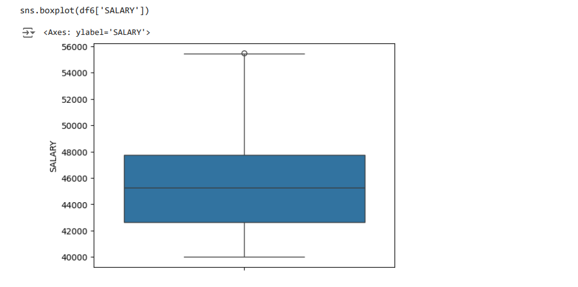

Slide 9
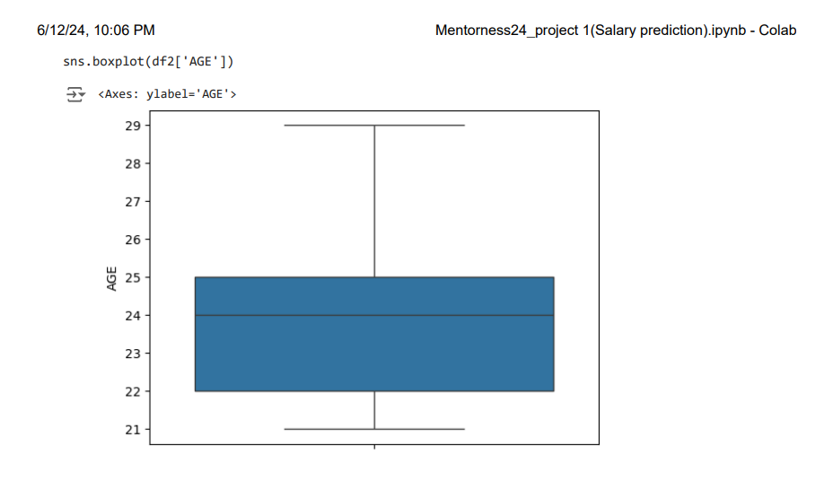

Slide 10
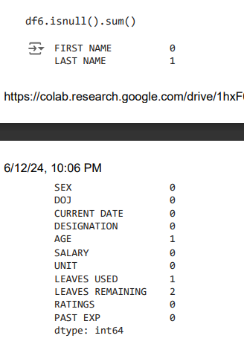
Now i have removed the null rows if the no.of rows are 1 else i have filled the missing or null values in the rows of specific columns with a suitable value
Before removing null values

Slide 11
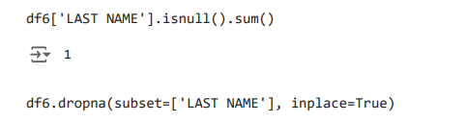
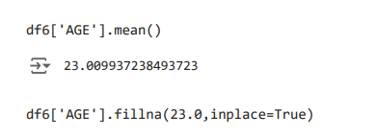
removing null values from LAST NAME column.
filiing the null values in AGE column with the their mean

Slide 12
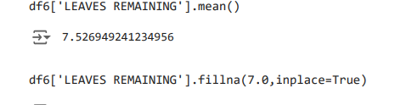
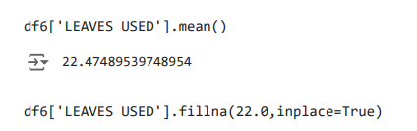
filling the null values in LEAVES REMAINING column with their mean
filling the null values in LEAVES USED column with their mean

Slide 13
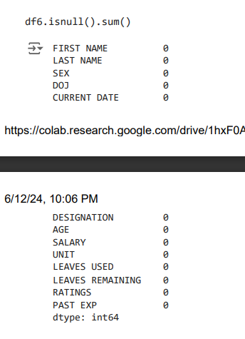
After clearing the null values or filling the null values

Slide 14
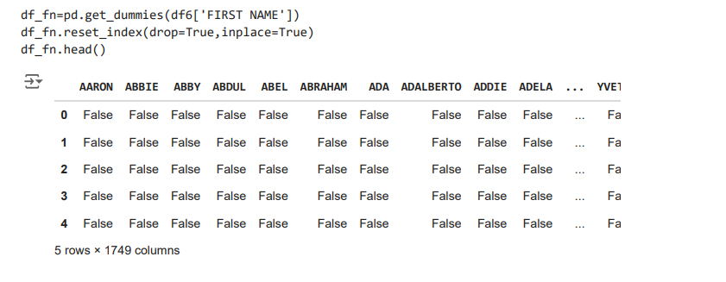
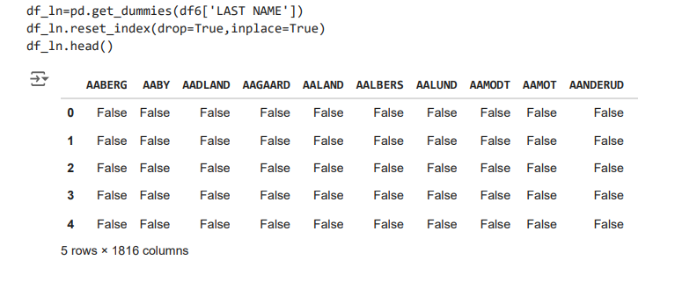
Now create the dummies for the data having string datatype.

Slide 15
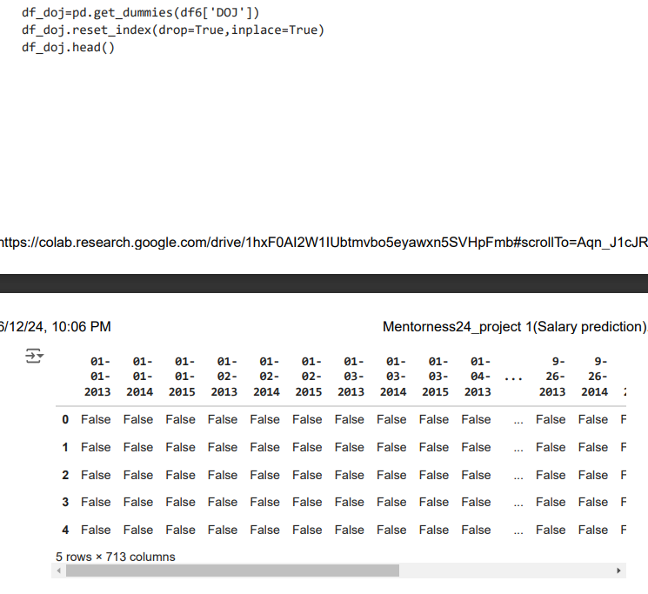

Slide 16
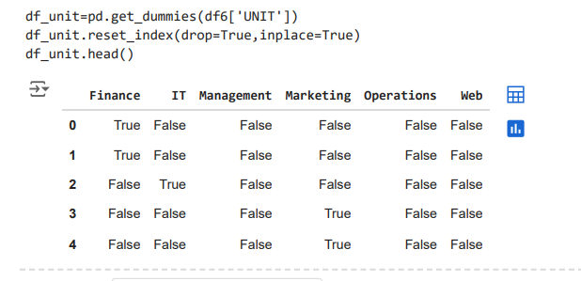
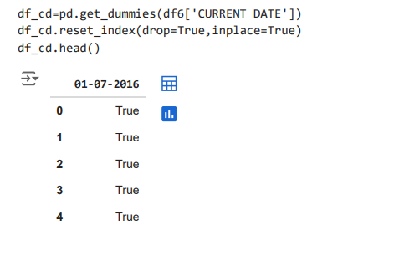

Slide 17
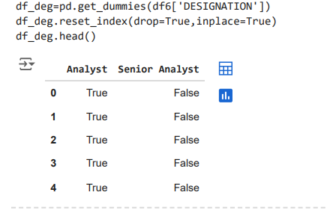
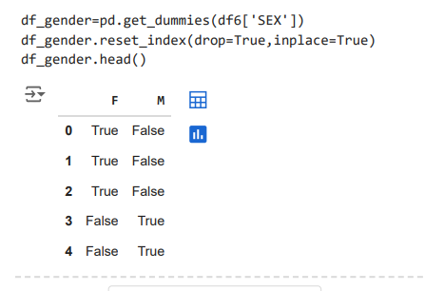

Slide 18
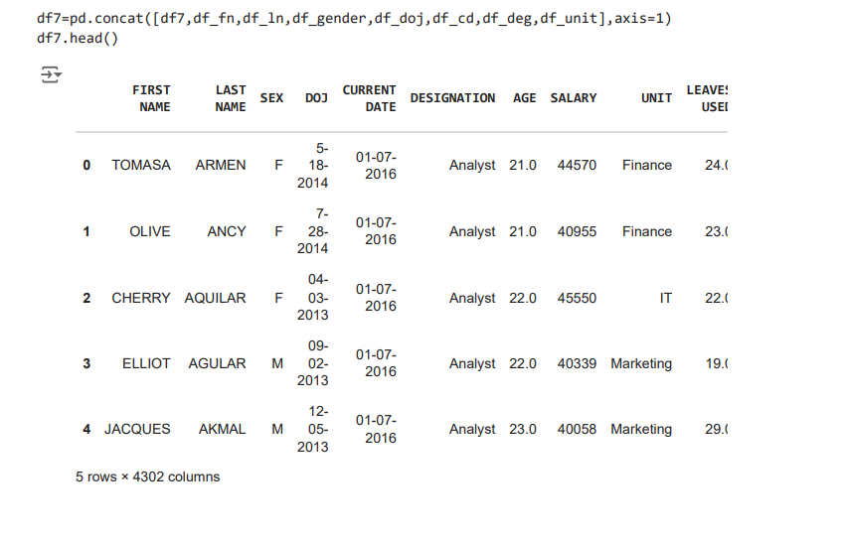
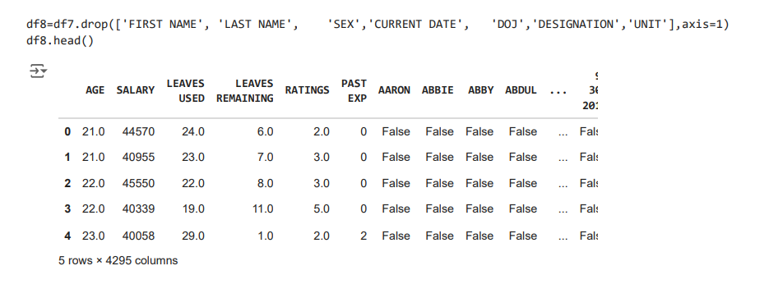

Slide 19
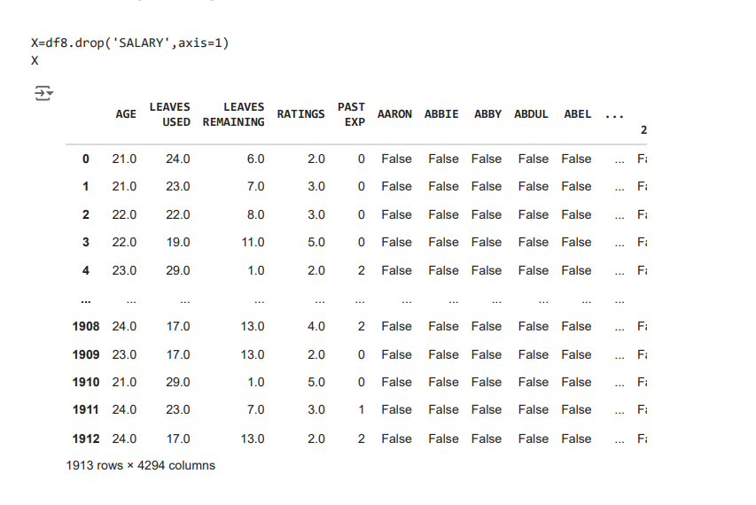
These are the features represented by X

Slide 20
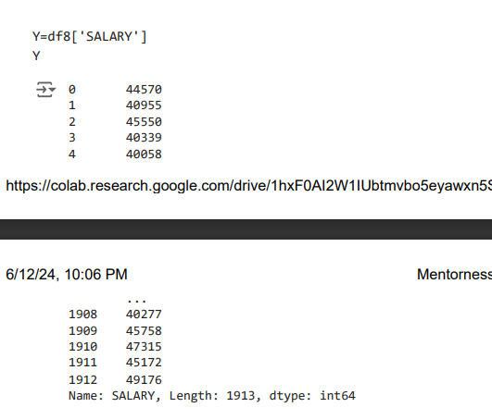
These are the labels represented by Y.

Slide 21
LET’S TRAIN DIFFERENT MODELS ON OBTAINED DATA

Slide 22
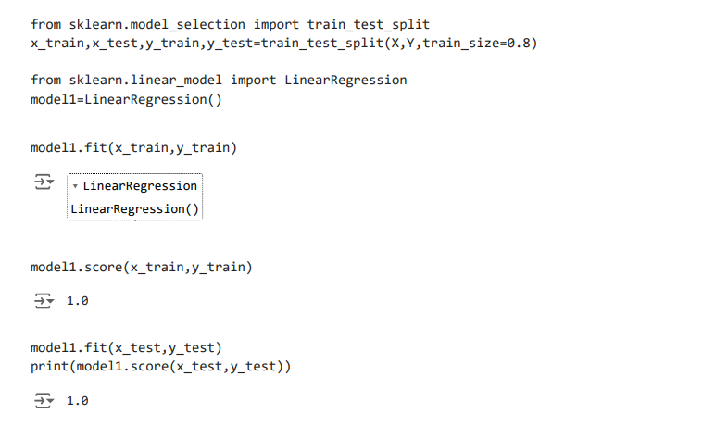
Let’s us first start with linear regression model

Slide 23
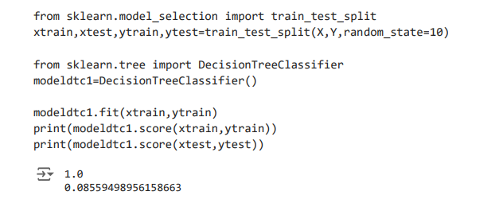
Second one is the Decision Tree Classifier
Before applying oversampling

Slide 24
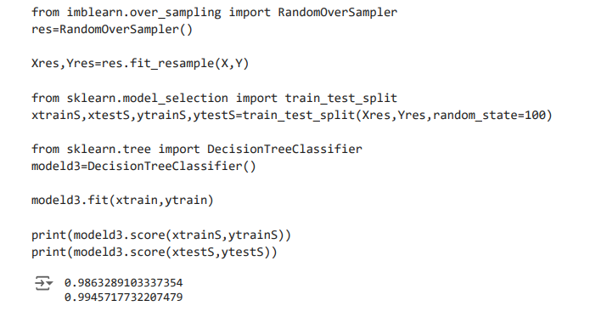
After oversampling the data.

Slide 25
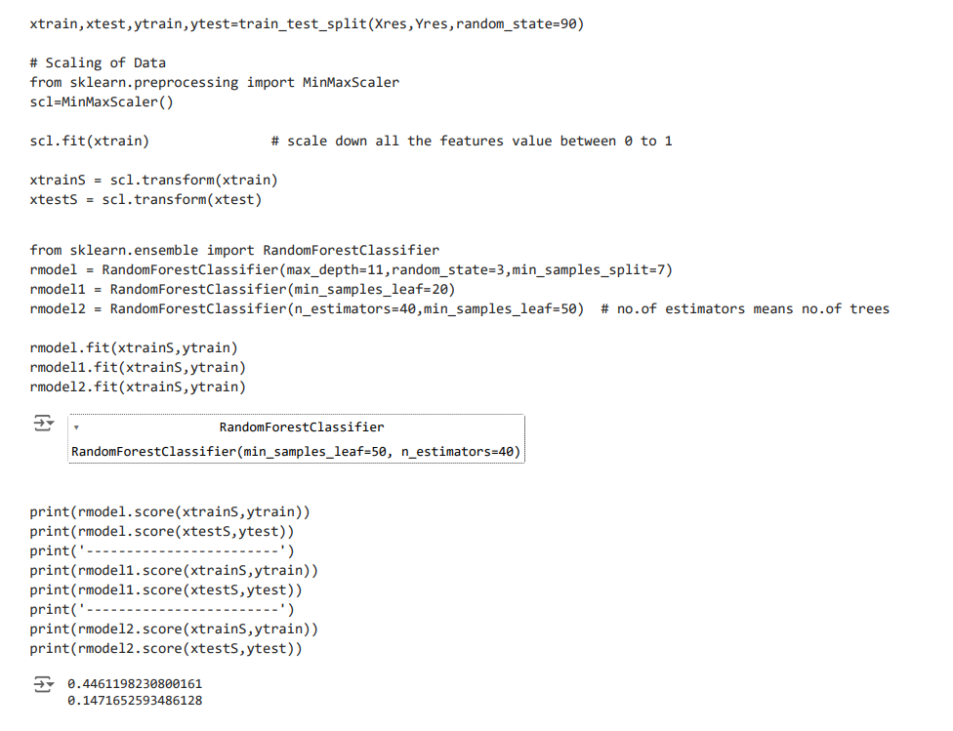
Random Forest Classifier

Slide 26
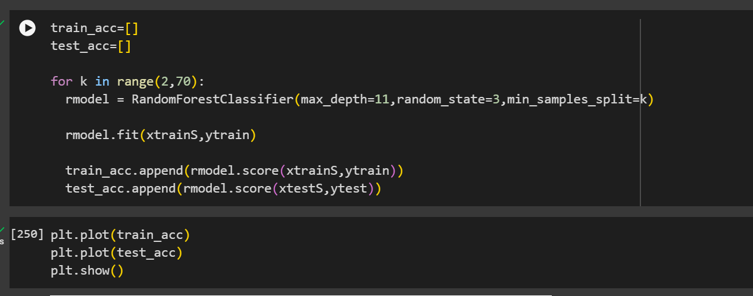
Here using max_depth,random_state and min_samples_split and variating the min_sample_split in for loop

Slide 27
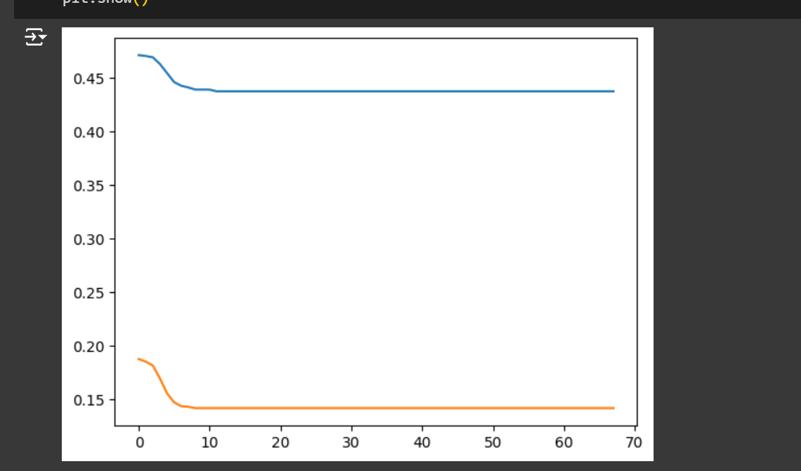

Slide 28
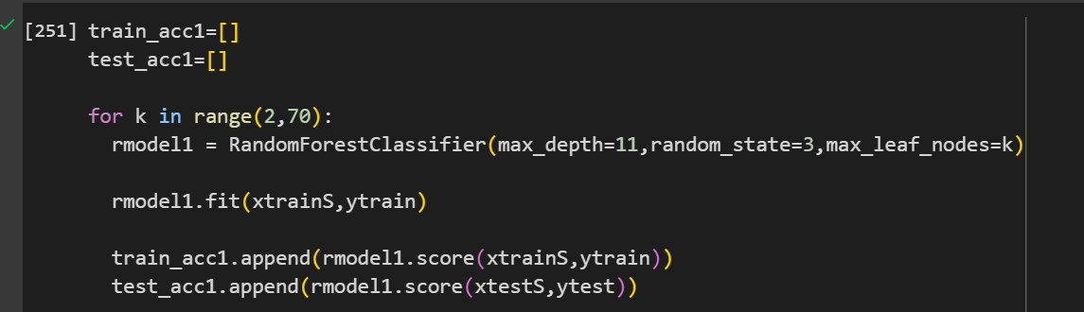
Here using max_depth,random_state and max_leaf_nodes as parameters and varaiting the max_leaf_nodes in for loop

Slide 29
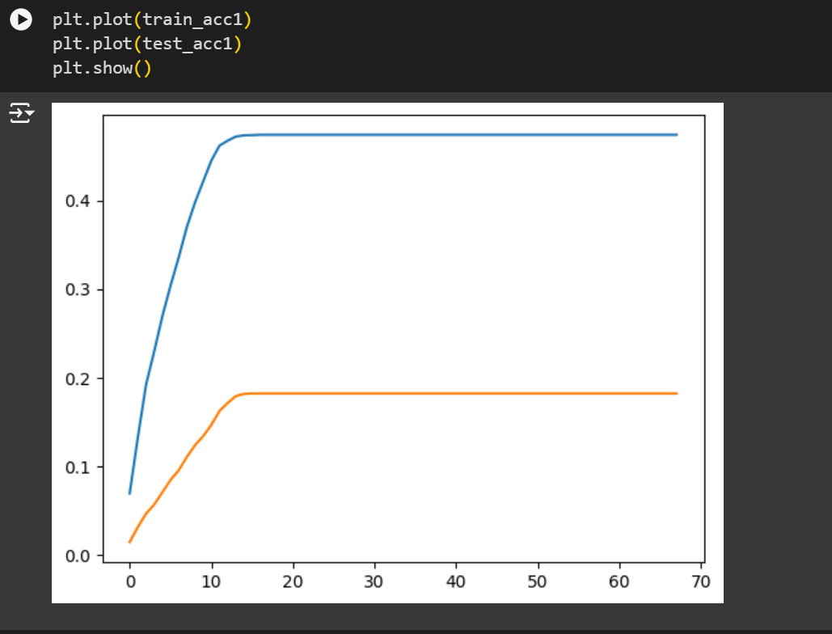

Slide 30
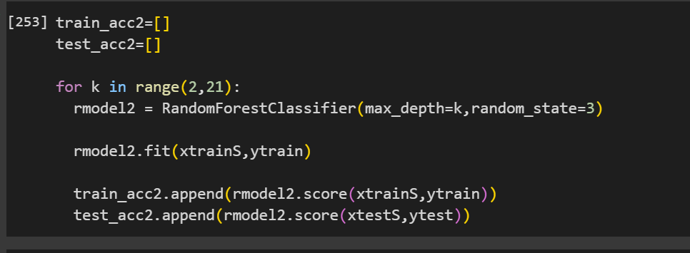
Here using max_depth and random_state as parameters and varaiting max_depth in for loop

Slide 31
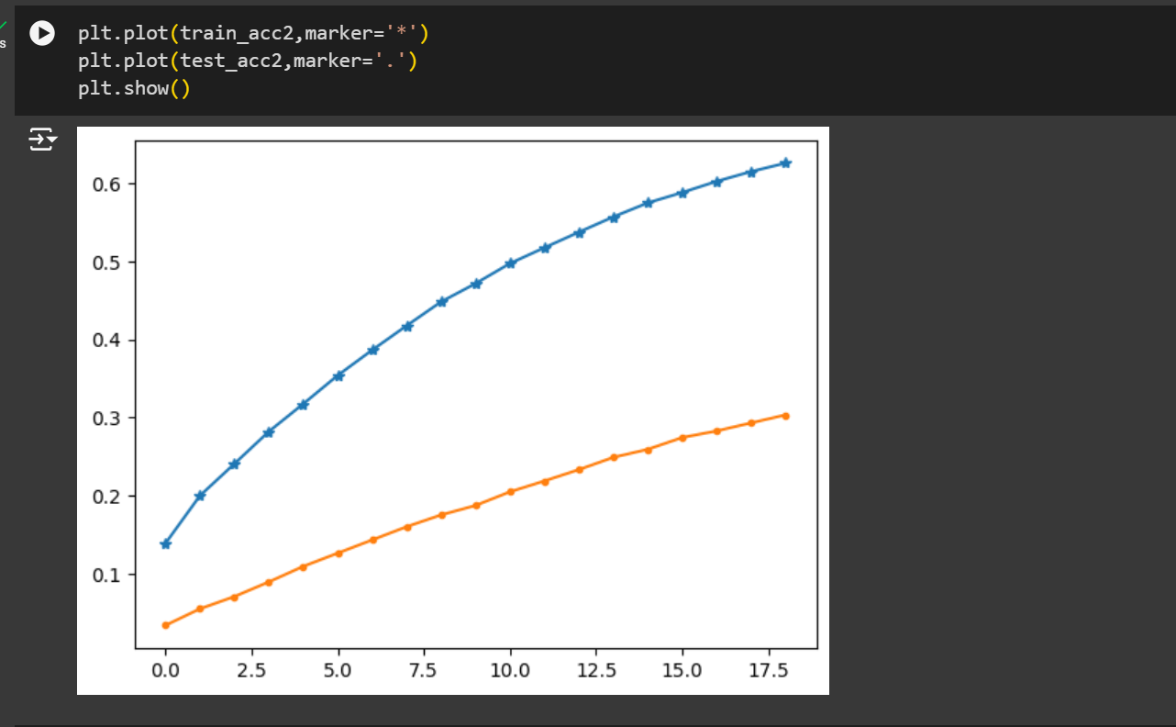

Slide 32
From the observation, we can conclude that linear regression gives the better score for given data as it is predicting the continuous values(salary)

Slide 33
THANK
YOU

